Slide 1
An Introduction to Software Engineering

Slide 2
What is a software process model?
A simplified representation of a software process, presented from a specific perspective.
Examples of process perspectives are
  Workflow perspective - sequence of activities;
  Data-flow perspective - information flow;
  Role/action perspective - who does what.
Generic process models
  Waterfall;
  Iterative development;
  Component-based software engineering.

Slide 3
What are the costs of software engineering?
Roughly 60% of costs are development costs, 40% are testing costs. For custom software, evolution costs often exceed development costs.
Costs vary depending on the type of system being developed and the requirements of system attributes such as performance and system reliability.
Distribution of costs depends on the development model that is used.

Slide 4
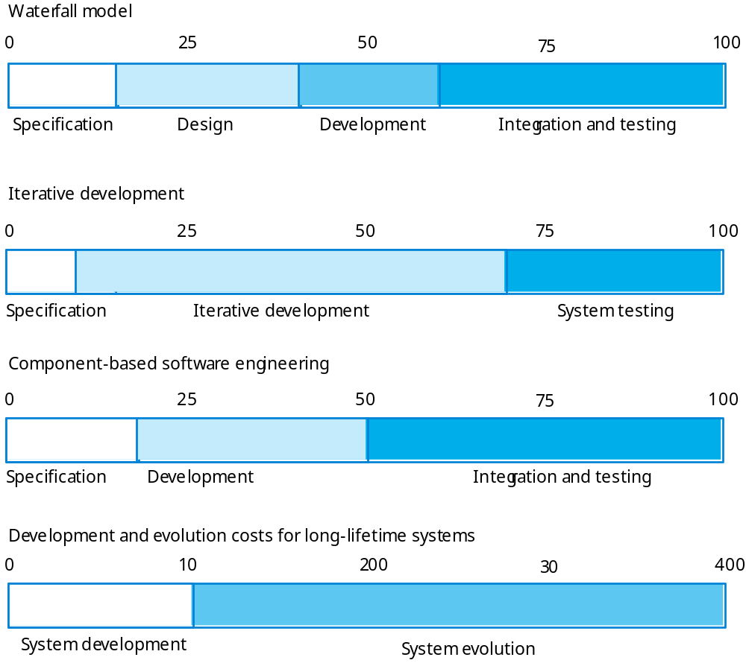
Activity cost distribution

Slide 5
What is CASE (Computer-Aided Software Engineering)
Software systems that are intended to provide automated support for software process activities.
CASE systems are often used for method support.
Upper-CASE
  Tools to support the early process activities of requirements and design;
Lower-CASE
  Tools to support later activities such as programming, debugging and testing.

Slide 6
What are the attributes of good software?
The software should deliver the required functionality and performance to the user and should be maintainable, dependable and acceptable.
Maintainability
  Software must evolve to meet changing needs;
Dependability
  Software must be trustworthy;
Efficiency
  Software should not make wasteful use of system resources;
Acceptability
  Software must accepted by the users for which it was designed. This means it must be understandable, usable and compatible with other systems.

Slide 7
What are the key challenges facing software engineering?
Heterogeneity, delivery and trust.
Heterogeneity
  Developing techniques for building software that can cope with heterogeneous platforms and execution environments;
Delivery
  Developing techniques that lead to faster delivery of software;
Trust
  Developing techniques that demonstrate that software can be trusted by its users.

Slide 8
Professional and ethical responsibility
Software engineering involves wider responsibilities than simply the application of technical skills.
Software engineers must behave in an honest and ethically responsible way if they are to be respected as professionals.
Ethical behaviour is more than simply upholding the law.

Slide 9
Issues of professional responsibility
Confidentiality
  Engineers should normally respect the confidentiality of their employers or clients irrespective of whether or not a formal confidentiality agreement has been signed.
Competence
  Engineers should not misrepresent their level of competence. They should not knowingly accept work which is outwith their competence.

Slide 10
Issues of professional responsibility
Intellectual property rights
  Engineers should be aware of local laws governing the use of intellectual property such as patents, copyright, etc. They should be careful to ensure that the intellectual property of employers and clients is protected.
Computer misuse
  Software engineers should not use their technical skills to misuse other people’s computers. Computer misuse ranges from relatively trivial (game playing on an employer’s machine, say) to extremely serious (dissemination of viruses).

Slide 11
ACM/IEEE Code of Ethics
The professional societies in the US have cooperated to produce a code of ethical practice.
Members of these organisations sign up to the code of practice when they join.
The Code contains eight Principles related to the behaviour of and decisions made by professional software engineers, including practitioners, educators, managers, supervisors and policy makers, as well as trainees and students of the profession.

Slide 12
Code of ethics - principles
PUBLIC
  Software engineers shall act consistently with the public interest.
CLIENT AND EMPLOYER
  Software engineers shall act in a manner that is in the best interests of their client and employer consistent with the public interest.
PRODUCT
  Software engineers shall ensure that their products and related modifications meet the highest professional standards possible.

Slide 13
Code of ethics - principles
JUDGMENT
  Software engineers shall maintain integrity and independence in their professional judgment.
MANAGEMENT
  Software engineering managers and leaders shall subscribe to and promote an ethical approach to the management of software development and maintenance.
PROFESSION
  Software engineers shall advance the integrity and reputation of the profession consistent with the public interest.

Slide 14
Code of ethics - principles
COLLEAGUES
  Software engineers shall be fair to and supportive of their colleagues.
SELF
  Software engineers shall participate in lifelong learning regarding the practice of their profession and shall promote an ethical approach to the practice of the profession.

Slide 15
Ethical dilemmas
Disagreement in principle with the policies of senior management.
Your employer acts in an unethical way and releases a safety-critical system without finishing the testing of the system.
Participation in the development of military weapons systems or nuclear systems.

Slide 16
Key points
Software engineering is an engineering discipline that is concerned with all aspects of software production.
Software products consist of developed programs and associated documentation. Essential product attributes are maintainability, dependability, efficiency and usability.
The software process consists of activities that are involved in developing software products. Basic activities are software specification, development, validation and evolution.

Slide 17
Key points
Methods are organised ways of producing software. They include suggestions for the process to be followed, the notations to be used, rules governing the system descriptions which are produced and design guidelines.
CASE tools are software systems which are designed to support routine activities in the software process such as editing design diagrams, checking diagram consistency and keeping track of program tests which have been run.
Software engineers have responsibilities to the engineering profession and society. They should not simply be concerned with technical issues.
Professional societies publish codes of conduct which set out the standards of behaviour expected of their members.

